Slide 1

Eagle_2nd PHY_Rework

Slide 2
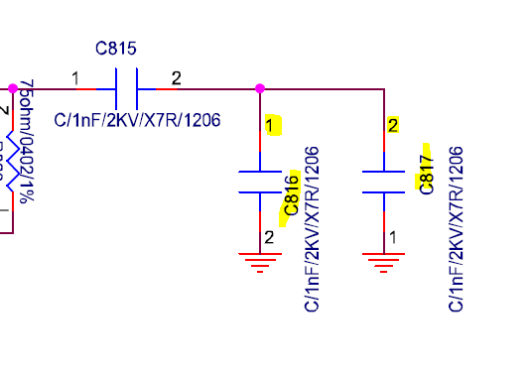
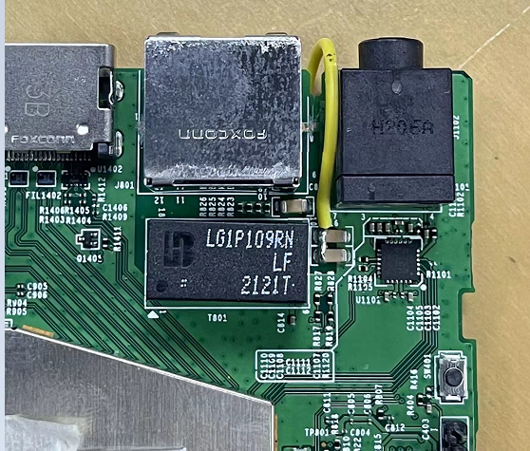
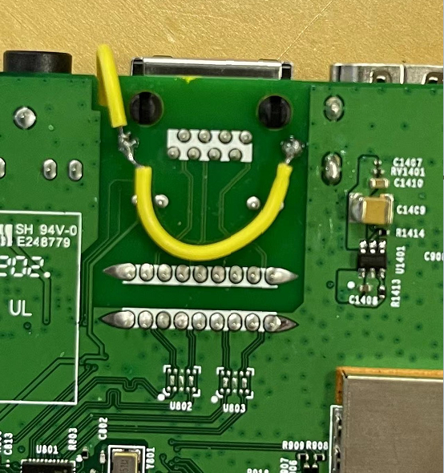
Rework 1
1. Cut off RJ45 S1, S2 GND pin, Jump wire RJ45 S1, S2 to C816, C817 pin1

Slide 3
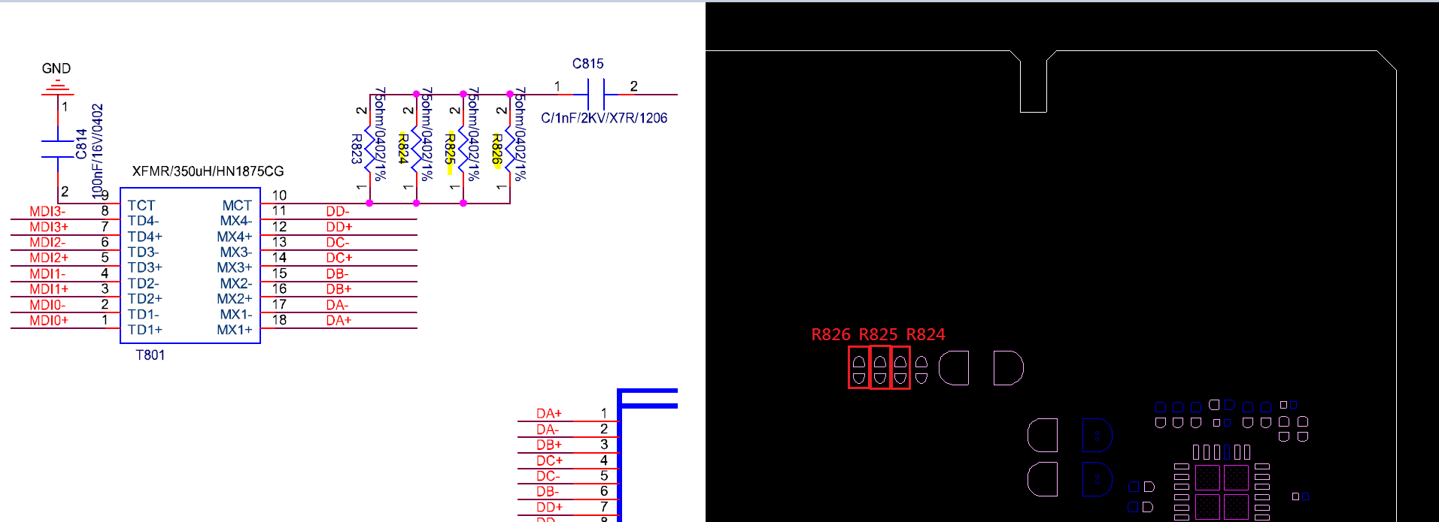
Rework 2
Remove the resistor R824, R825, R826

Slide 4
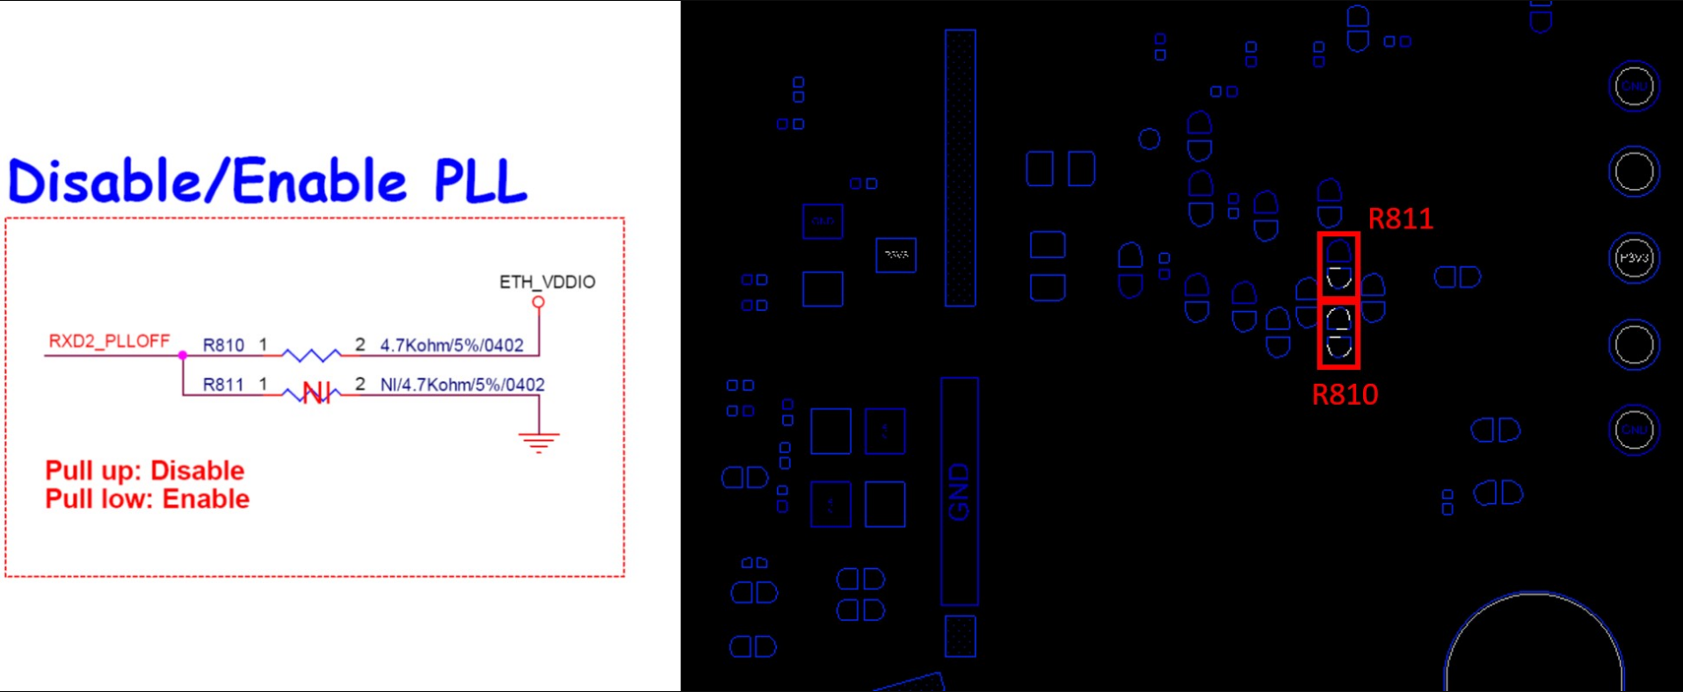
Rework 3
move the resistor on R810 to R811

